Slide 1


Smart Construction Management System
Proudly presented by Group 3:
Zun Khet Wai - 6514552552
Adnan Ali - 6522040531
Rohan Prasad Gupta - 6522040549
Hay Man Htun - 6514552498
Kyaw Maung Maung Thwin - 6522040648

Slide 2
Table of Content
Introduction
Our Focus
Objectives
Architecture Overview
Users Stories and acceptance criteria
Dashboard
Results

Slide 3
Introduction
Meet with SGD 3: Good Health and Well being
Computerized platforms designed to streamline and automate various aspects of construction project management.
Use advanced technologies such as the Internet of Things (IoT), Artificial Intelligence (AI), and Machine Learning (ML) to gather, process, and analyze data.
Is to improve efficiency, reduce waste, and enhance safety and quality on construction sites.
It provides stakeholders with real-time visibility into project status and progress.
Main focus is better collaboration and communication among team members, as well as faster decision-making when issues arise.

Slide 4

Our Focus
Labour Management
No of labors on site
Budgeting
Amount of overtime
Emergency and Safety
Inform about the emergency of labor
Notify the emergency alert

Slide 5
Objectives
01
As a construction manager, I want to be informed that how many labours come to the construction site so that I can calculate and estimate the number of labours on the construction site.
02
As a construction manager, in order to determine the amount of overtime, I need to see the laborers' overtime hours.
03
As a construction manager, I want to be informed of an emergency labour situation so that I can notify to the emergency team.
04
As a labour, I want to notify the emergency alert so that I can get the emergency response.

Slide 6

User Story 1:
User stories and acceptance criteria
As a construction manager, I want to be informed that how many labours come to the construction site so that I can calculate and estimate the number of labours on the construction site.
Scenario: attendance of labours, given actual labours on the construction site, when the labours entering to the construction site, then verify the location and current status during working hours.
100%
Result

Slide 7

User Story 2:
User stories and acceptance criteria
2. As a construction manager, in order to determine the amount of overtime, I need to see the laborers' overtime hours.
Scenario: labour after working hours, given number of labours, when stay working on construction site.
100%
Result

Slide 8

User Story 3:
User stories and acceptance
3. As a construction manager, I want to be informed of an emergency labour situation so that I can notify to the emergency team.
Scenario: Emergency aid needed, given Wifi Connection, when Emergency needed from injured labour, then necessary data of injured labour will send to the construction supervisor with Wifi Connection to call emergency team.
100%
Result

Slide 9

User Story 4:
User stories and acceptance
4. As a labour, I want to notify the emergency alert so that I can get the emergency respond.
Scenario: The labour is injured, given Wifi connection, when injury happened, then I will press the injured alert button.
Scenario: Fire Case, given Wifi connection, when Fire burning occurs, then I will press the fire alert button.
100%
Result

Slide 10
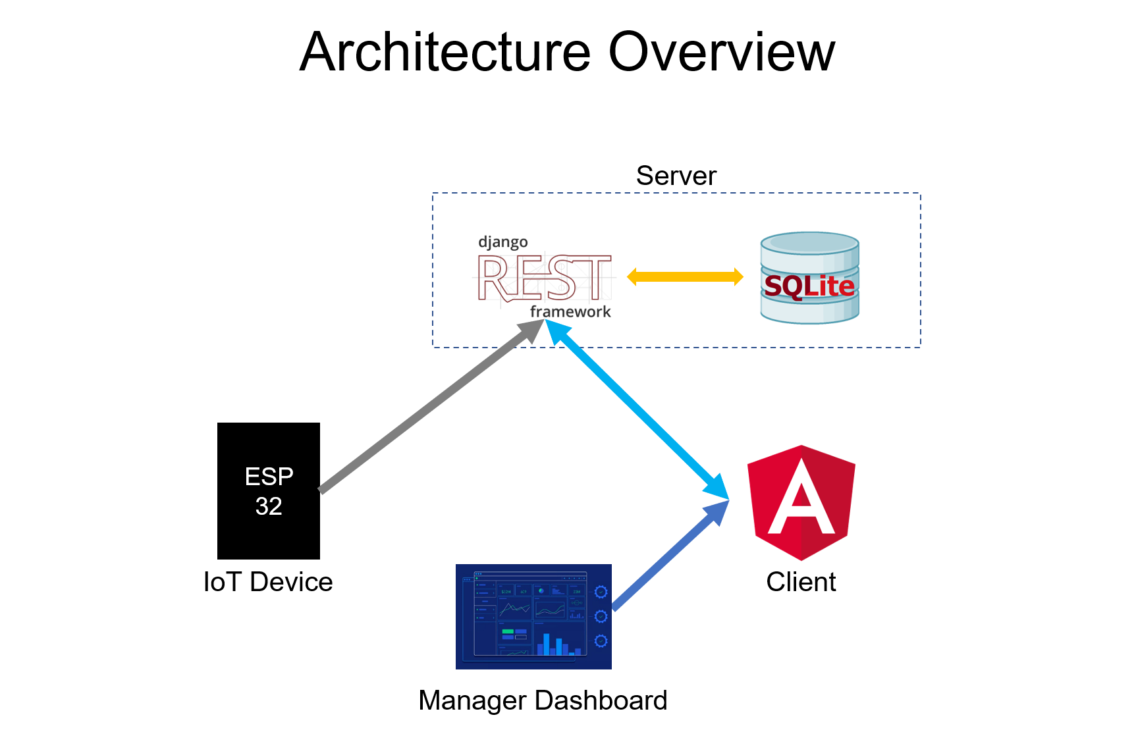

Slide 11
Overview Hardware
Libraries and Tools Used:
ArduinoJson: A library for encoding and decoding JSON documents
U8g2lib: A library for controlling monochrome OLED displays
NTPClient: A library for handling NTP (Network Time Protocol) to get the current time
WiFi, WiFiUDP, and HTTPClient: Libraries for managing Wi-Fi connections and HTTP requests
Pin Configuration:
Button: Connected to pin 0
OLED Display: SDA connected to pin 4, SCL connected to pin 15, and RST connected to pin 16

Slide 12
ESP 32 + GPS module
System Architecture:
The system connects to Wi-Fi and reads GPS data from a GPS module.
It checks the button state and sends location data to the Django API every 3 minutes or when the button is pressed.
The emergency_case parameter is included in the API request based on the button state (1 for emergency when the button is pressed, 0 for regular updates).
System Architecture:
The system connects to Wifi and obtains the current time using NTP.
It displays the current time on the OLED display.
When the button is pressed, it sends an emergency signal to the Django API with the current latitude and longitude.
The OLED display shows the status of the emergency signal (e.g., "Fire Alarm reported").

Slide 13
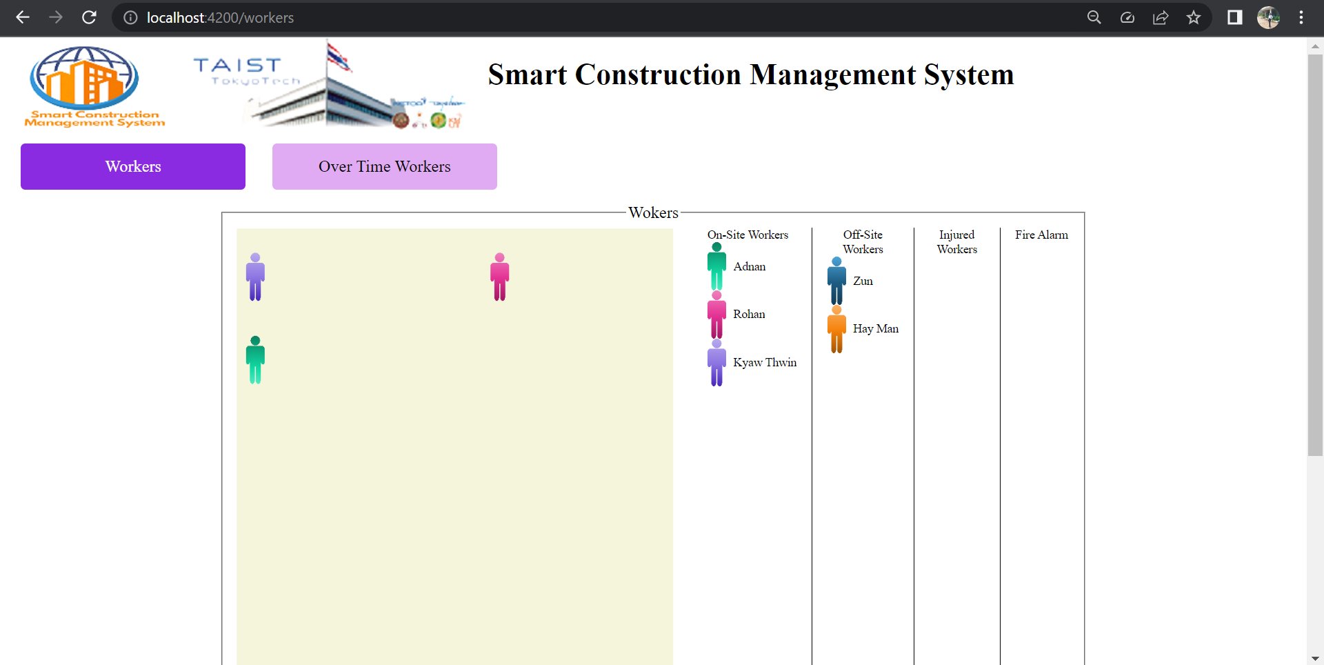
Our Dashboard

Slide 14
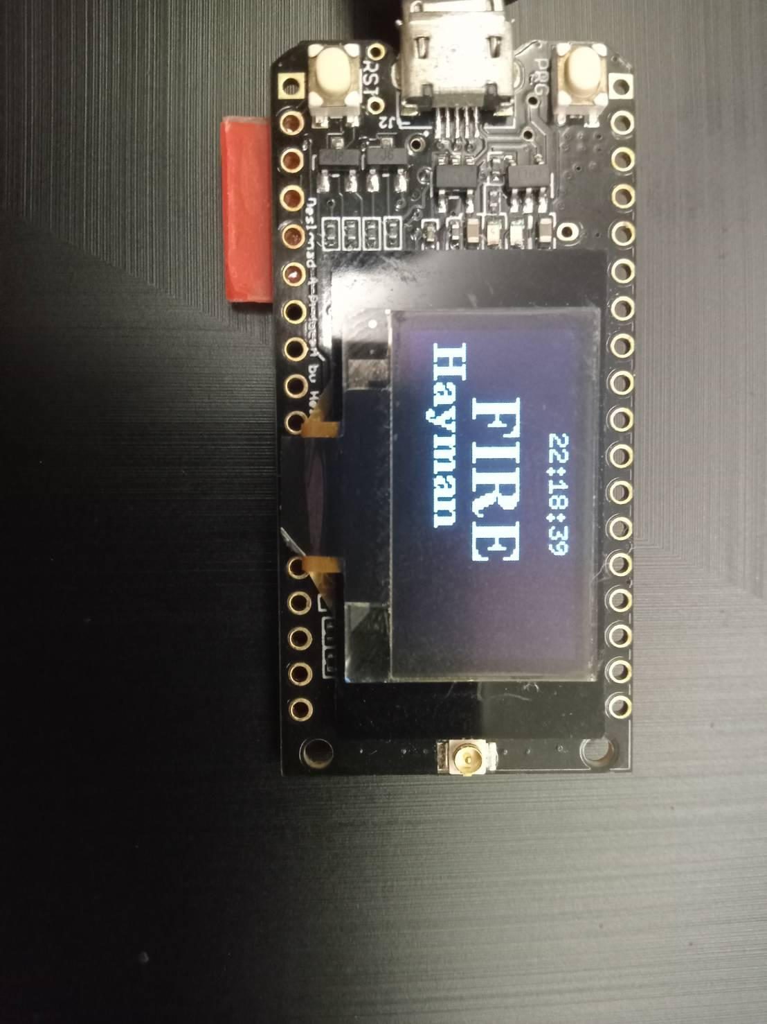
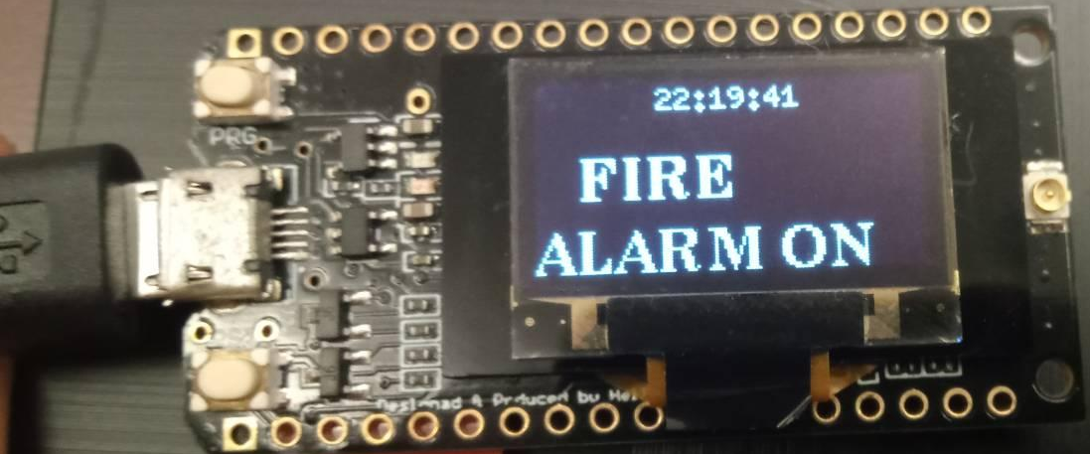
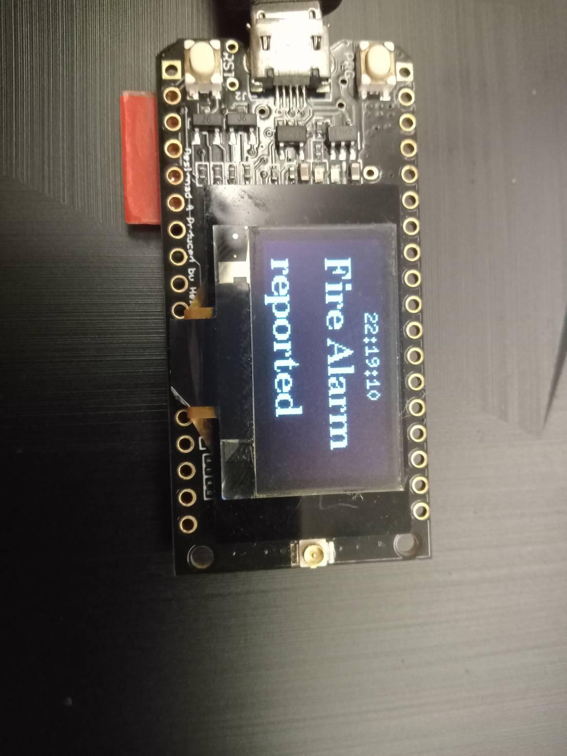
Fire Alarm case
Status Fire case
Displayed in ESP32

Slide 15
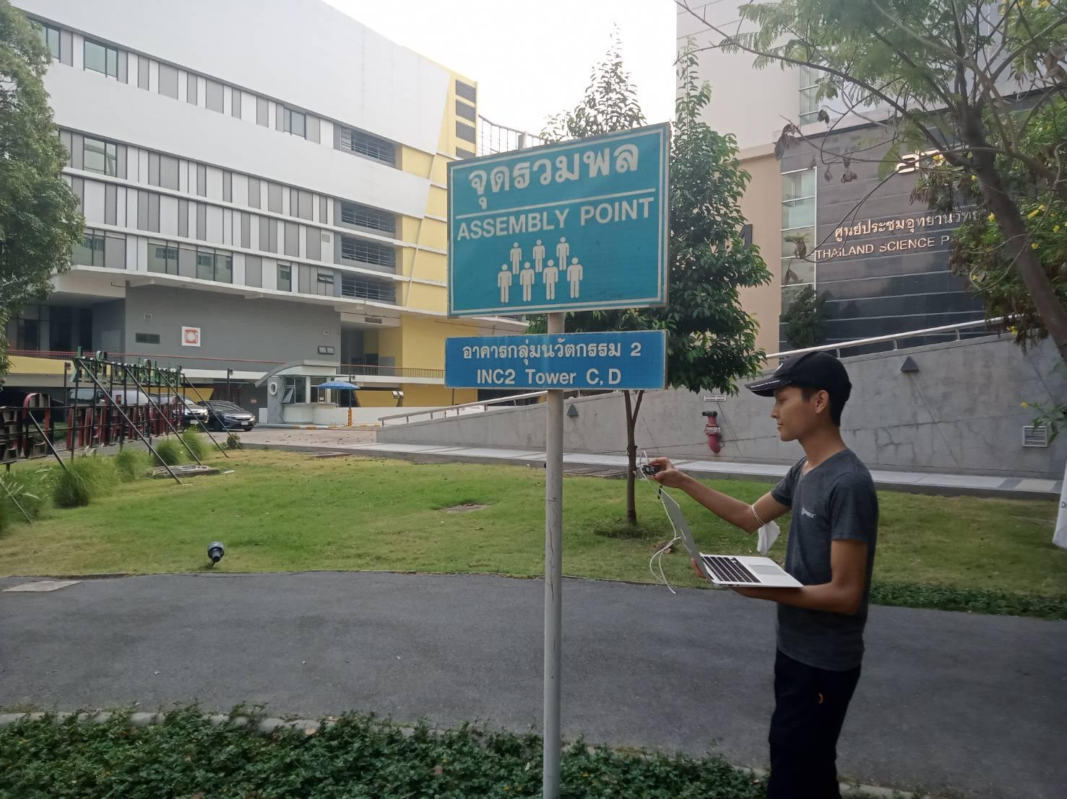
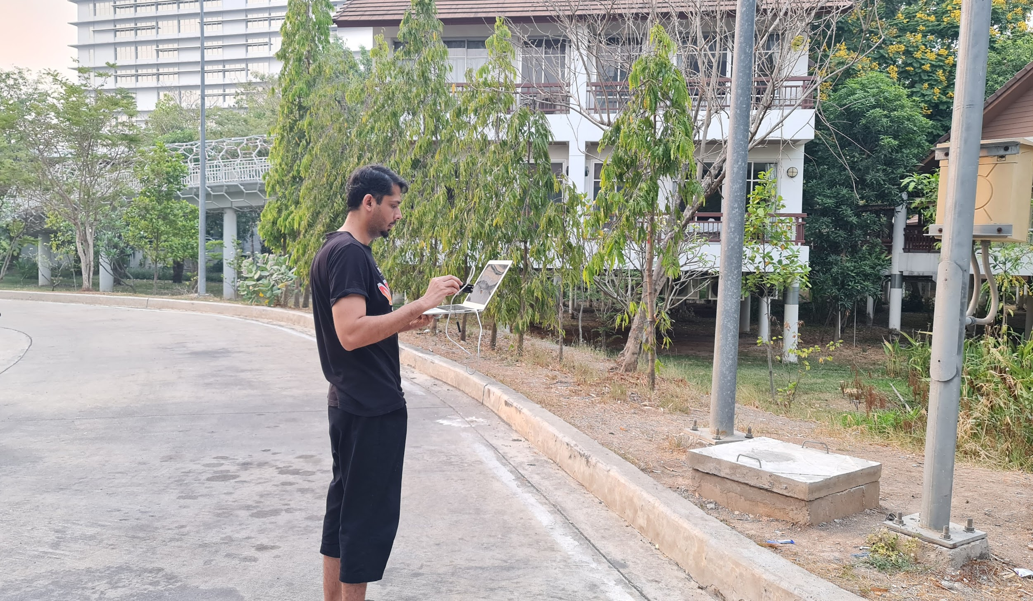
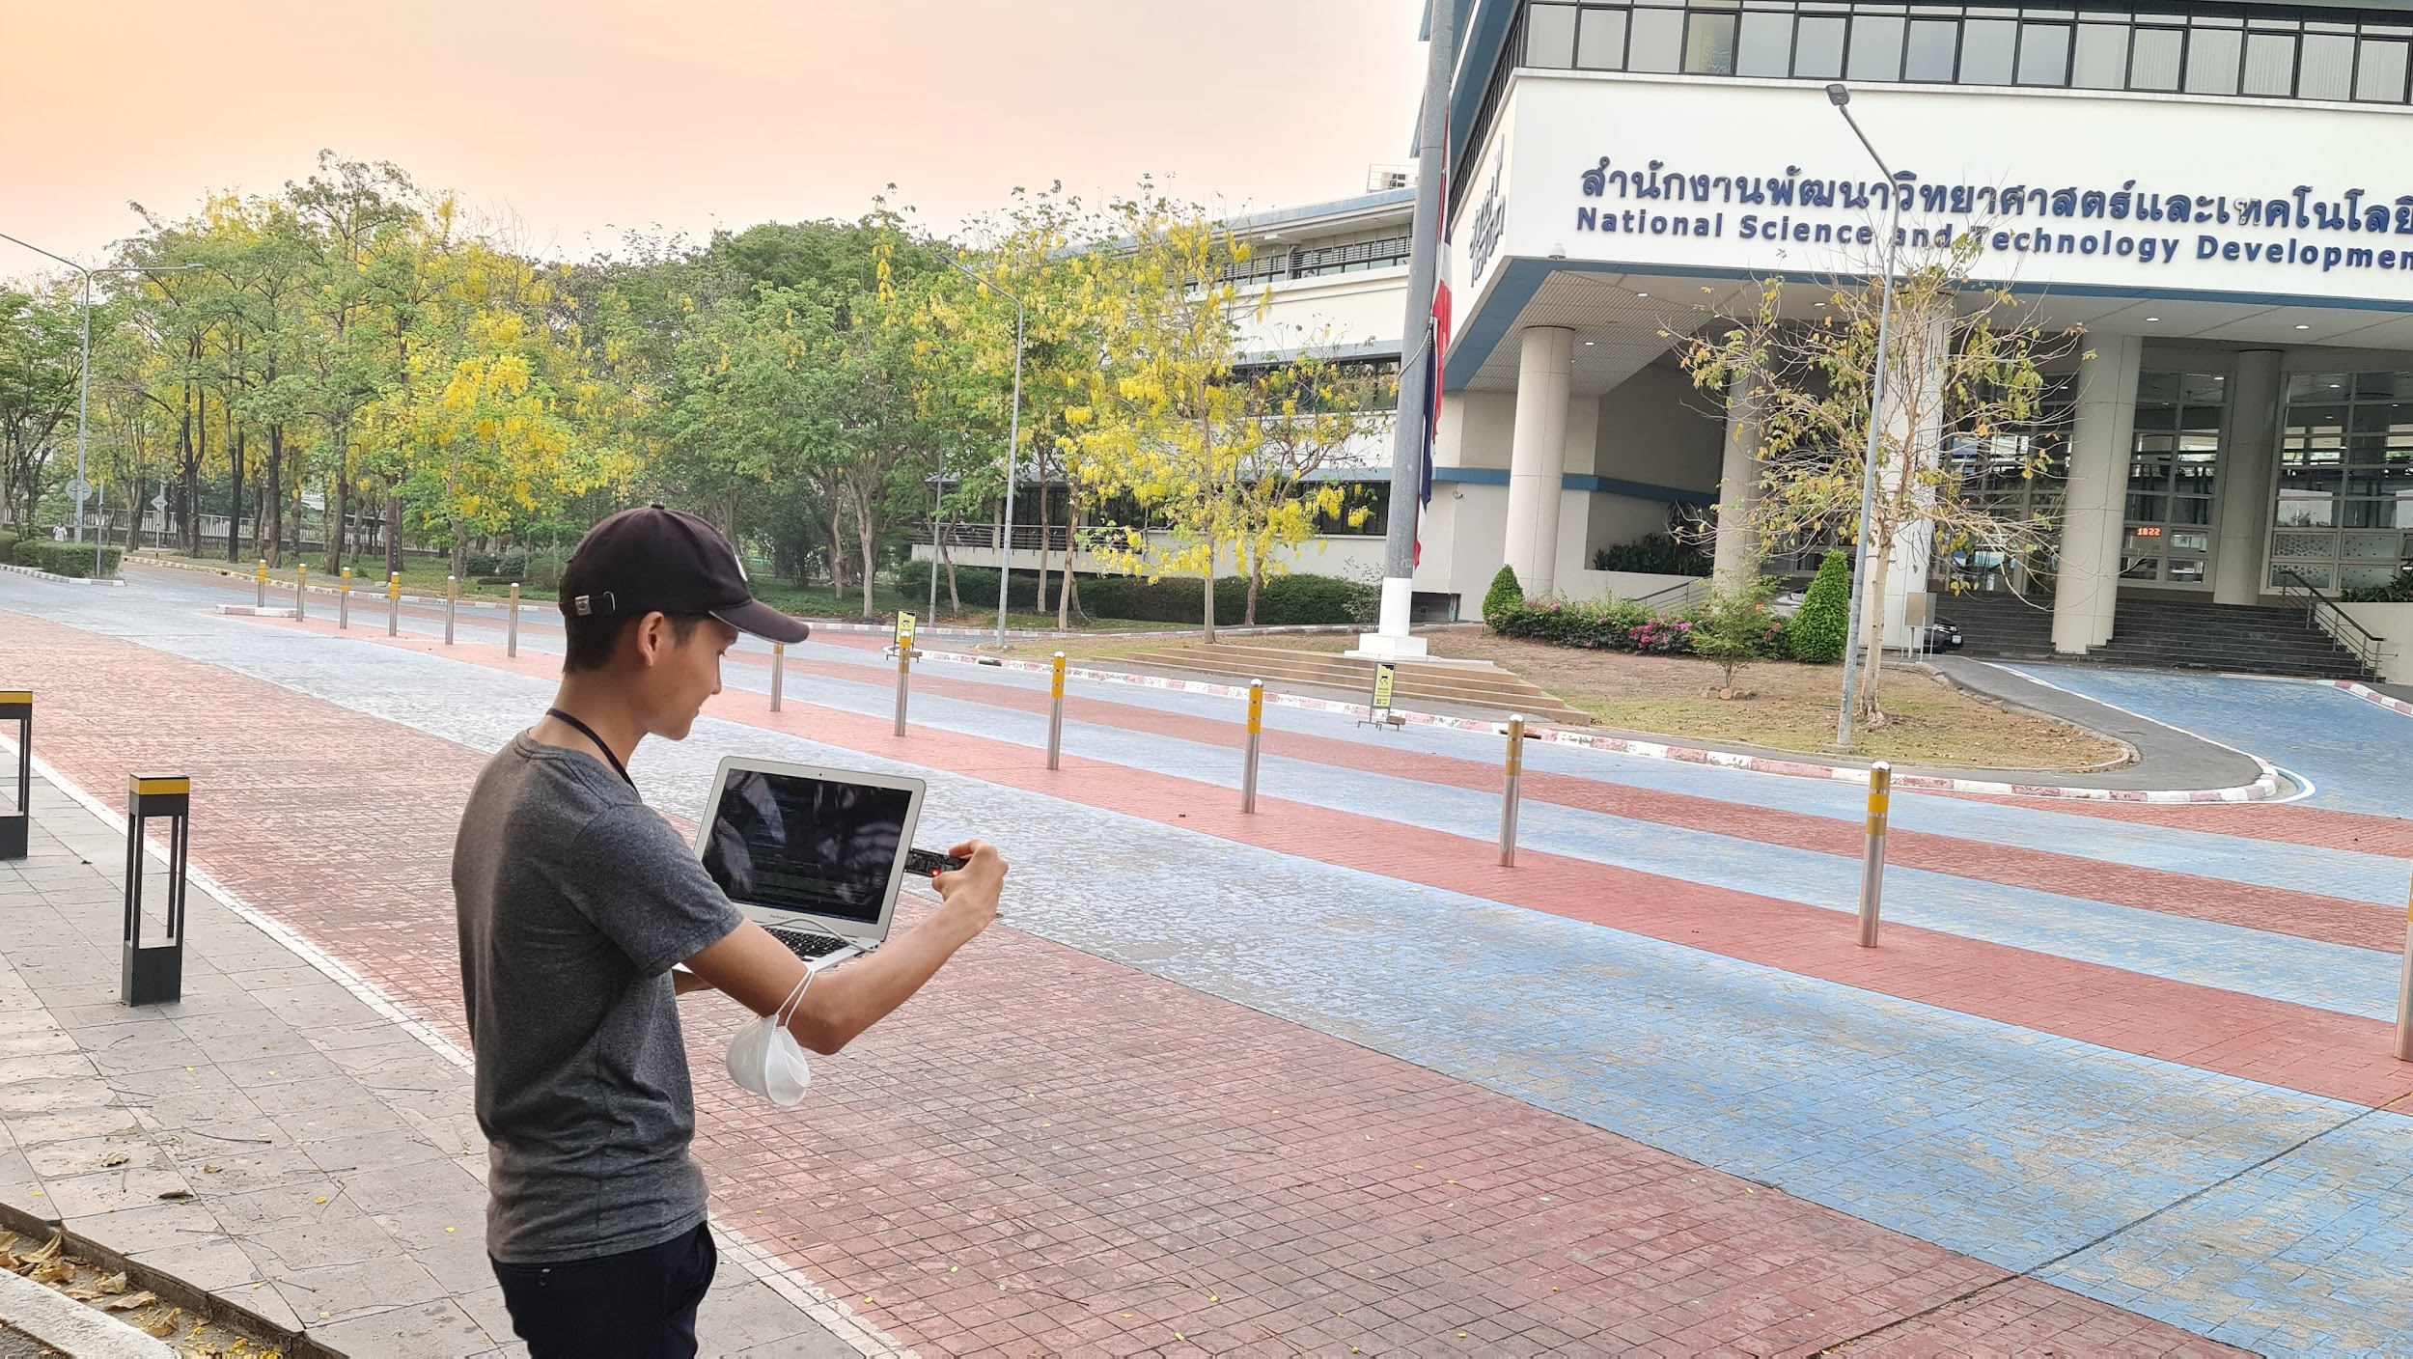
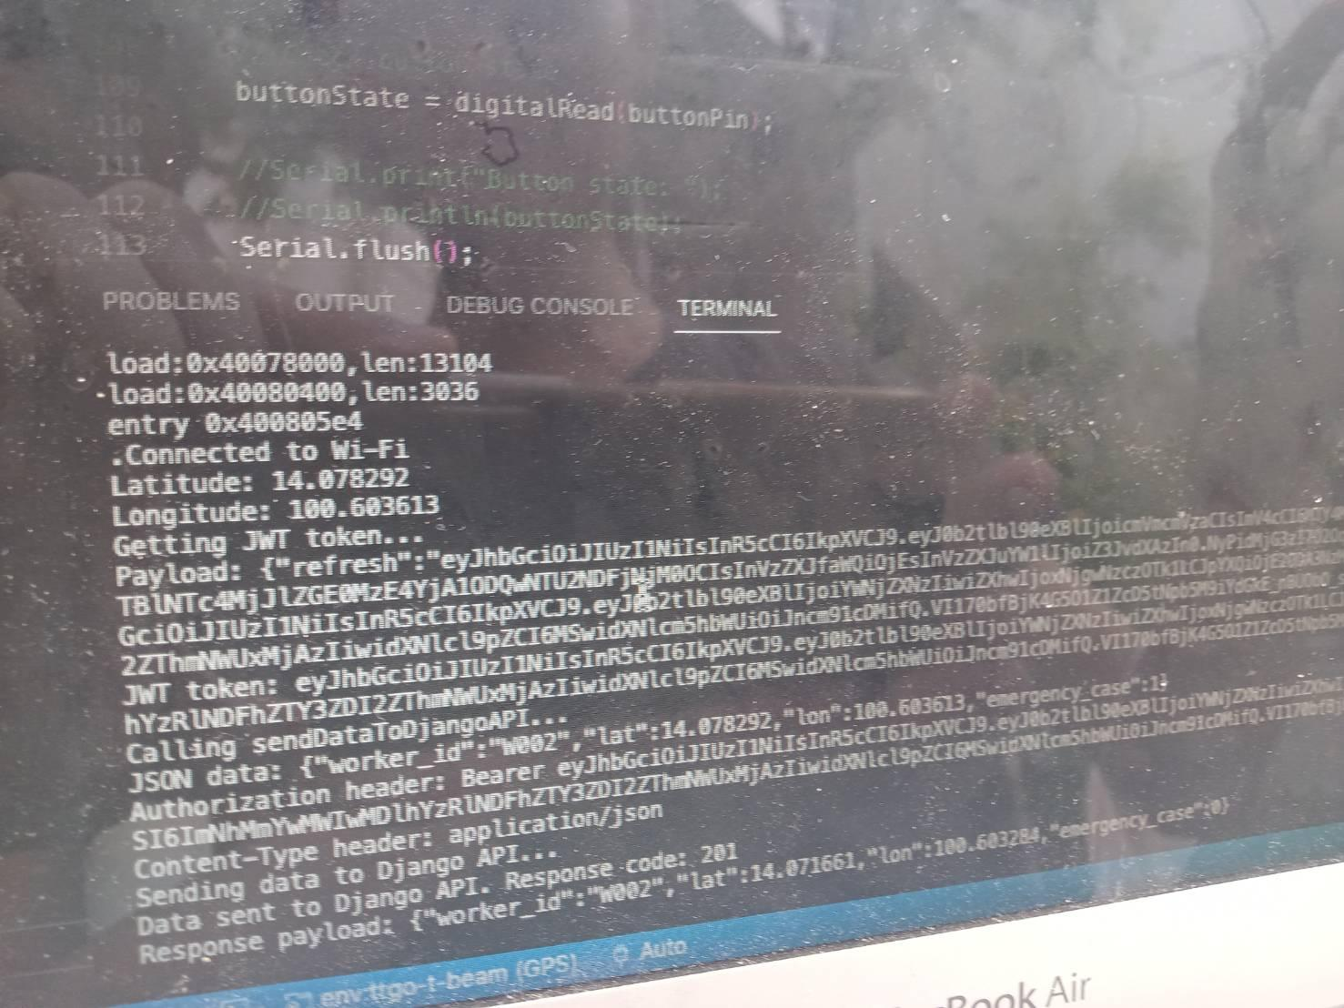
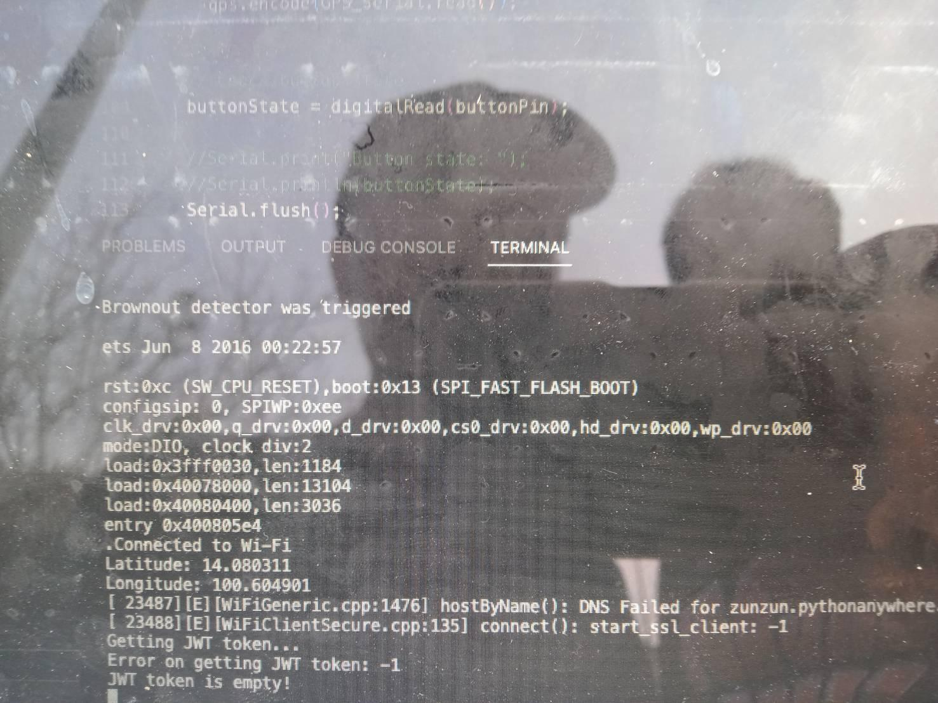
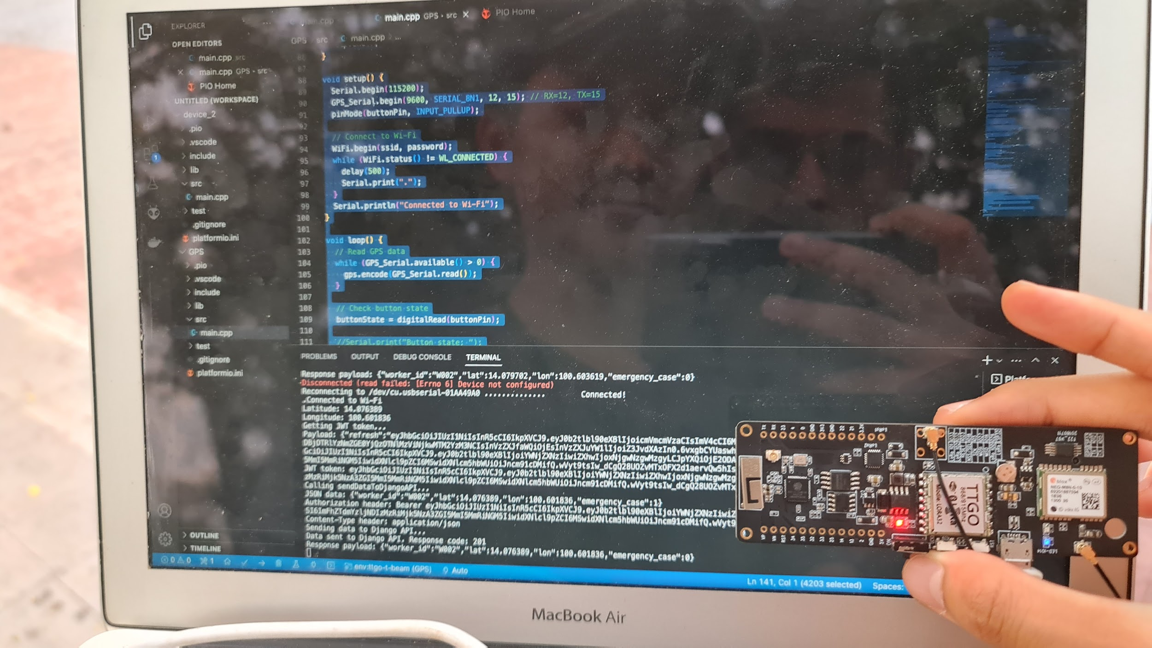
On-Site Testing
Diagonal value assign
First point
Second point
Outside the coverage
Inside Coverage

Slide 16
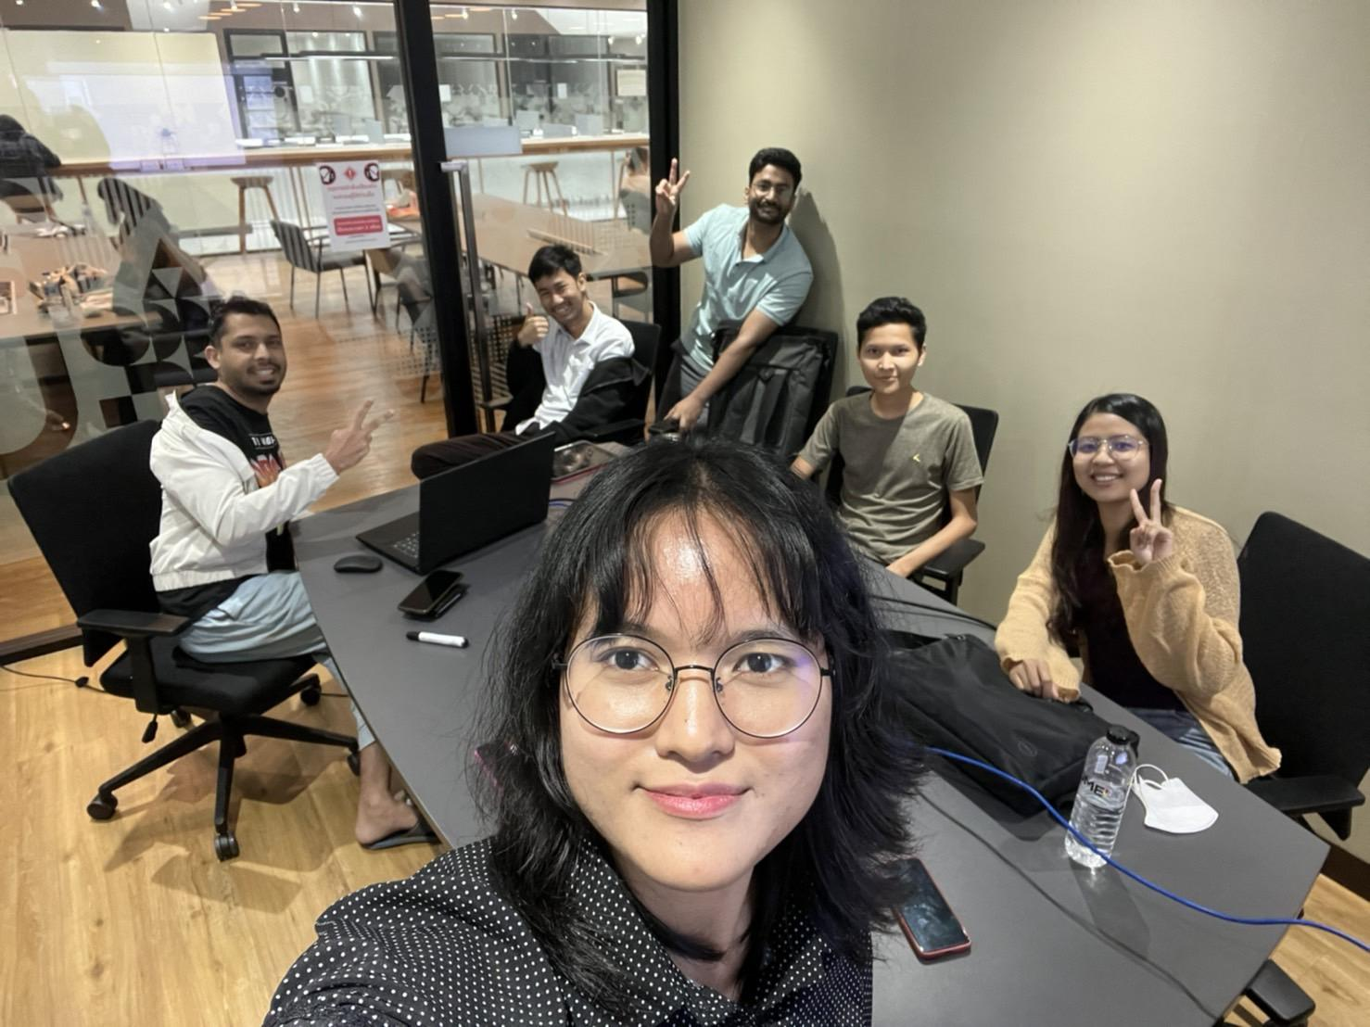

Memory of group meeting
Thanks you
Its show time…..

